Slide 1


Calculus and applications
MTH10012
Week 8

Slide 2
Introduction
Week 7
Taylor’s and MacLaurin’s formulas
Antidifferentiation, fundamental integrals, integration by substitution, integration of products of trig/hyp functions (part 1)
MODULE 5
Week 8
Integration of products of trig/hyp functions (part 2)
Integration of rational functions and the method of partial fractions
Trigonometric and hyperbolic substitutions
Integration by parts

Slide 3
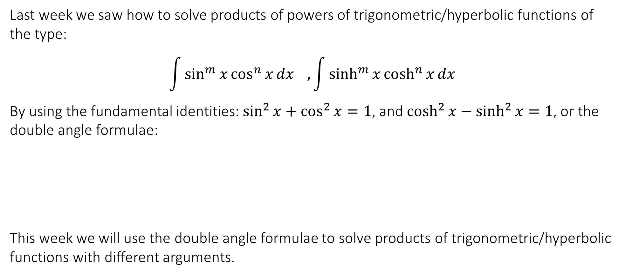
5.4 Integration of products of trigonometric/hyperbolic functions
Last week we saw how to solve products of powers of trigonometric/hyperbolic functions of the type:
$$\int{\sin^{m}{x}\cos^{n}{x}dx} ,\int{\sinh^{m}{x}\cosh^{n}{x}dx}$$
By using the fundamental identities: $\sin^{2}{x}+\cos^{2}{x}=1$, and $\cosh^{2}{x}−\sinh^{2}{x}=1$, or the double angle formulae:
This week we will use the double angle formulae to solve products of trigonometric/hyperbolic functions with different arguments.

Slide 4
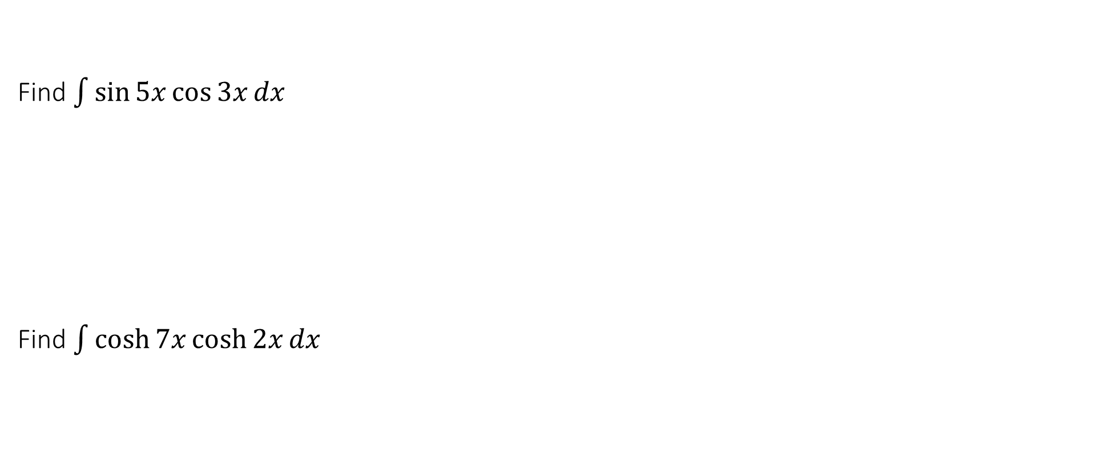
5.4 Integration of products of trigonometric/hyperbolic functions
Find $\int{\sin{5x}\cos{3x}dx}$
Find $\int{\cosh{7x}\cosh{2x}dx}$

Slide 5
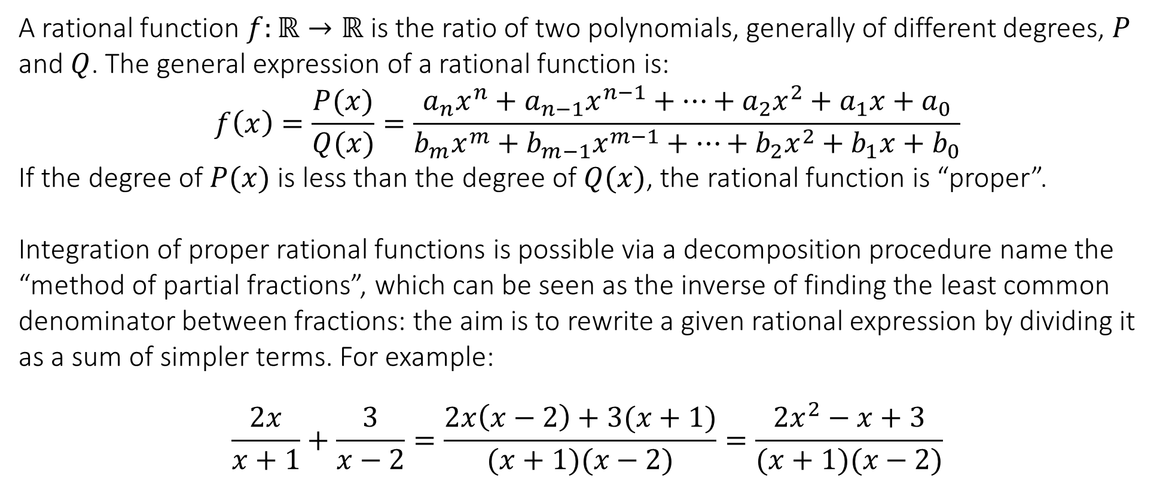
5.5 Integration of rational functions and the method of partial fractions
A rational function $f:ℝ→ℝ$ is the ratio of two polynomials, generally of different degrees, $P$ and $Q$. The general expression of a rational function is:
$$f\left(x\right)=\frac{P(x)}{Q(x)}=\frac{a_{n}x^{n}+a_{n−1}x^{n−1}+…+a_{2}x^{2}+a_{1}x+a_{0}}{b_{m}x^{m}+b_{m−1}x^{m−1}+…+b_{2}x^{2}+b_{1}x+b_{0}}$$
If the degree of $P(x)$ is less than the degree of $Q(x)$, the rational function is “proper”.
Integration of proper rational functions is possible via a decomposition procedure name the “method of partial fractions”, which can be seen as the inverse of finding the least common denominator between fractions: the aim is to rewrite a given rational expression by dividing it as a sum of simpler terms. For example:
$$\frac{2x}{x+1}+\frac{3}{x−2}=\frac{2x\left(x−2\right)+3(x+1)}{(x+1)(x−2)}=\frac{2x^{2}−x+3}{(x+1)(x−2)}$$
Method of partial fractions

Slide 6
5.5 Integration of rational functions and the method of partial fractions
We will only see cases where we assume that the denominator can always be expressed as a product of quadratic and/or linear terms.

Slide 7

5.5 Integration of rational functions and the method of partial fractions
Use partial fractions to evaluate
$$\int{\frac{x^{2}−4}{{\left(x−1\right)}^{2}(x+5)}dx}$$

Slide 8

5.5 Integration of rational functions and the method of partial fractions
Use partial fractions to evaluate
$$\int{\frac{4x}{(x^{2}+4)(x+1)}dx}$$

Slide 9

5.5 Integration of rational functions and the method of partial fractions
Use partial fractions to evaluate
$$\int{\frac{x^{2}−3x−8}{(x^{2}+4x+5)(x+1)}dx}$$

Slide 10
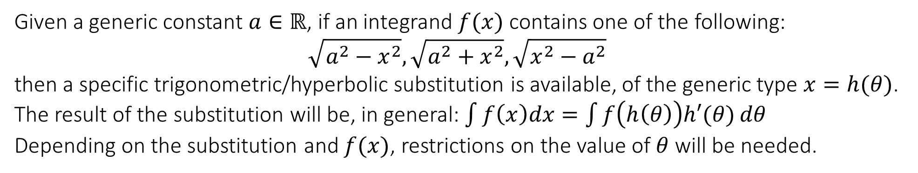
5.6 Trigonometric and hyperbolic substitutions
Given a generic constant $a∈ℝ$, if an integrand $f(x)$ contains one of the following:
$$\sqrt{a^{2}−x^{2}},\sqrt{a^{2}+x^{2}},\sqrt{x^{2}−a^{2}}$$
then a specific trigonometric/hyperbolic substitution is available, of the generic type $x=h(θ)$. The result of the substitution will be, in general:$\int{f\left(x\right)dx}=\int{f\left(h\left(θ\right)\right)h′(θ)}dθ$
Depending on the substitution and $f(x)$, restrictions on the value of $θ$ will be needed.

Slide 11

5.6 Trigonometric and hyperbolic substitutions
Find:
$$\int{\sqrt{4−x^{2}}}dx$$

Slide 12

5.6 Trigonometric and hyperbolic substitutions
Find:
$$\int{\frac{1}{\sqrt{3x^{2}−5}}}dx$$

Slide 13

5.6 Trigonometric and hyperbolic substitutions
Find:
$$\int{\frac{1}{\sqrt{x^{2}+4}}}dx$$

Slide 14

5.6 Trigonometric and hyperbolic substitutions
Find:
$$\int{\frac{1}{3x^{2}+7}}dx$$

Slide 15
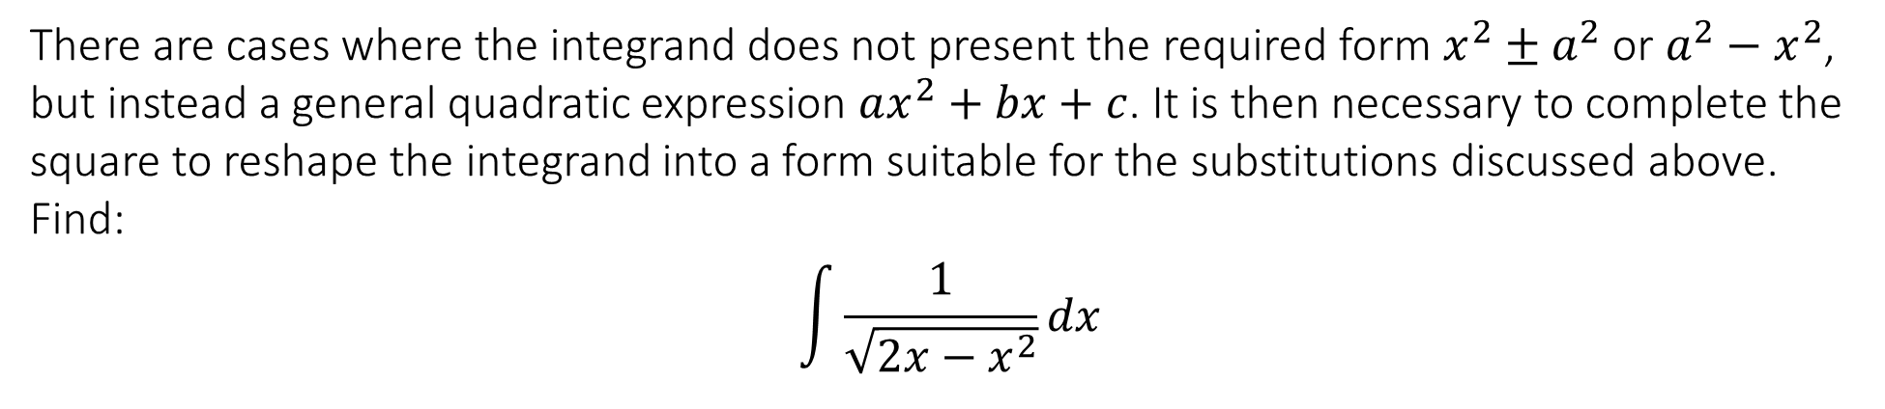
5.6 Trigonometric and hyperbolic substitutions
There are cases where the integrand does not present the required form $x^{2}±a^{2}$ or $a^{2}−x^{2}$, but instead a general quadratic expression $ax^{2}+bx+c$. It is then necessary to complete the square to reshape the integrand into a form suitable for the substitutions discussed above.
Find:
$$\int{\frac{1}{\sqrt{2x−x^{2}}}}dx$$

Slide 16
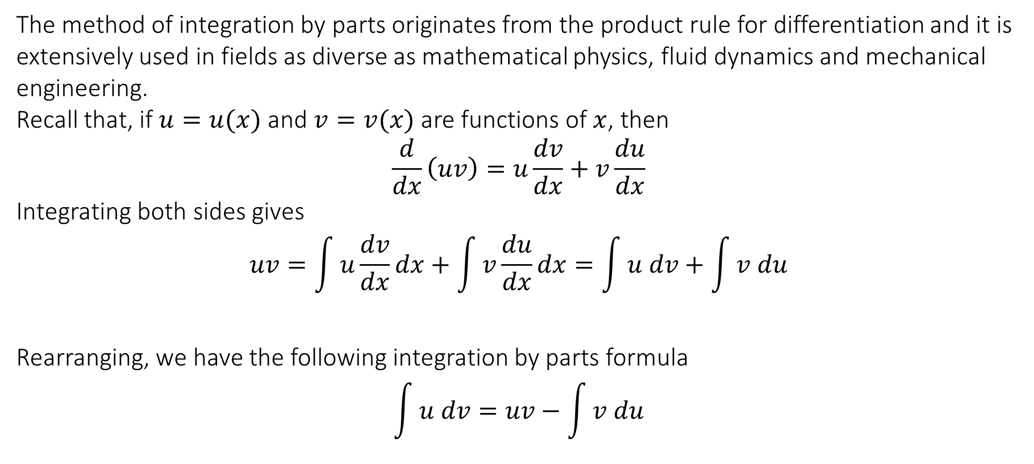
5.7 Integration by parts
The method of integration by parts originates from the product rule for differentiation and it is extensively used in fields as diverse as mathematical physics, fluid dynamics and mechanical engineering.
Recall that, if $u=u(x)$ and $v=v(x)$ are functions of $x$, then
$$\frac{d}{dx}\left(uv\right)=u\frac{dv}{dx}+v\frac{du}{dx}$$
Integrating both sides gives
$$uv=\int{u\frac{dv}{dx}dx}+\int{v\frac{du}{dx}dx}=\int{u dv}+\int{v du}$$
Rearranging, we have the following integration by parts formula
$$\int{u dv}=uv−\int{v du}$$

Slide 17
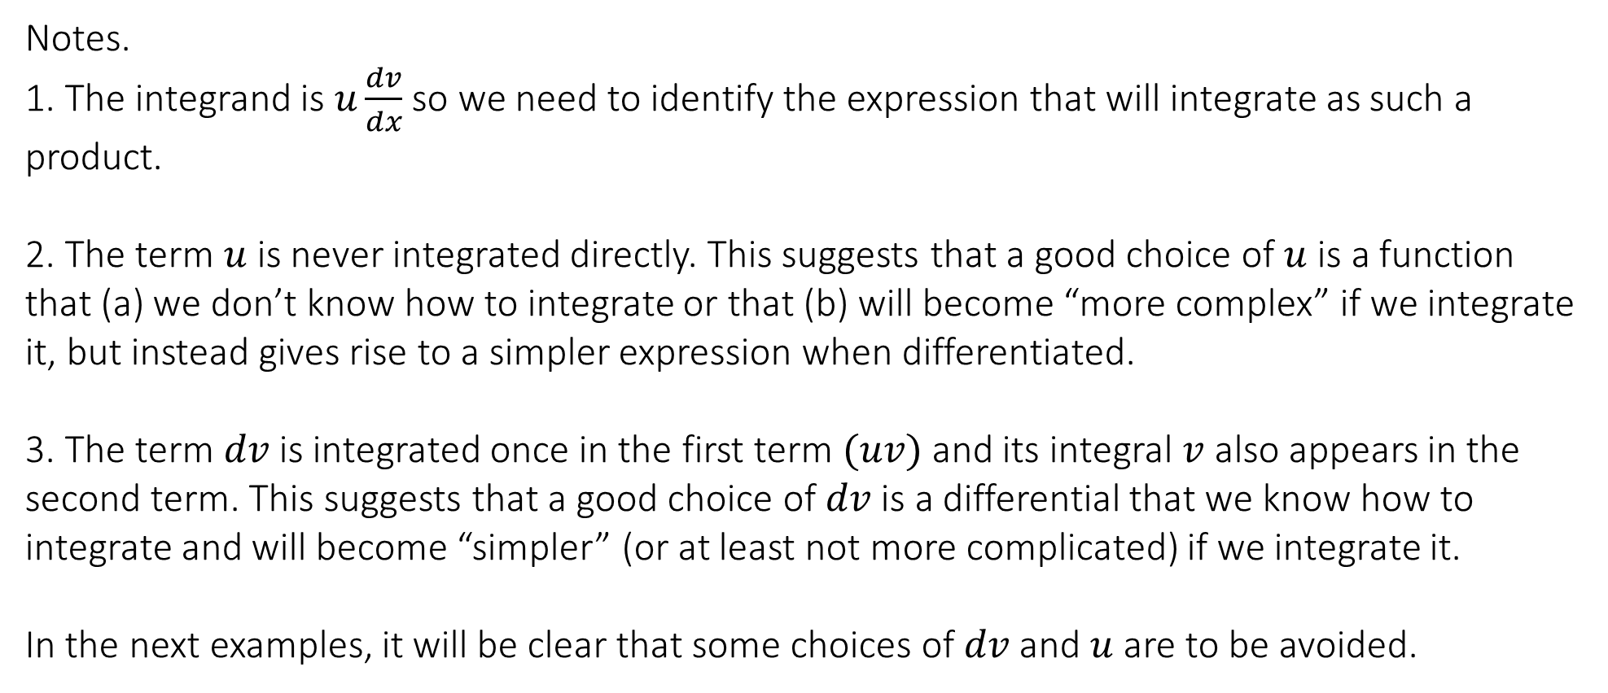
5.7 Integration by parts
Notes.
1. The integrand is $u\frac{dv}{dx}$ so we need to identify the expression that will integrate as such a product.
2. The term $u$ is never integrated directly. This suggests that a good choice of $u$ is a function that (a) we don’t know how to integrate or that (b) will become “more complex” if we integrate it, but instead gives rise to a simpler expression when differentiated.
3. The term $dv$ is integrated once in the first term $(uv)$ and its integral $v$ also appears in the second term. This suggests that a good choice of $dv$ is a differential that we know how to integrate and will become “simpler” (or at least not more complicated) if we integrate it.
In the next examples, it will be clear that some choices of $dv$ and $u$ are to be avoided.

Slide 18

5.7 Integration by parts
Find
$$\int{x e^{x}dx}$$

Slide 19

5.7 Integration by parts
Find
$$\int{x\cos{x}dx}$$
$$\int{x^{2}e^{x}dx}$$

Slide 20

5.7 Integration by parts
Find
$$\int{\ln{x}dx}$$
$$\int{x \ln{x}dx}$$

Slide 21

5.7 Integration by parts
Find
$$\int{e^{x}\sin{x}dx}$$

Slide 22
End of Lecture

